Slide 1

FINANCIAL PERFORMANCE DASHBOARD
Objective of the Project
Analyse financial performance across different countries, products, and time periods, using key financial metrics such as sales, profit, cost of goods sold (COGS), and discounts

Slide 2
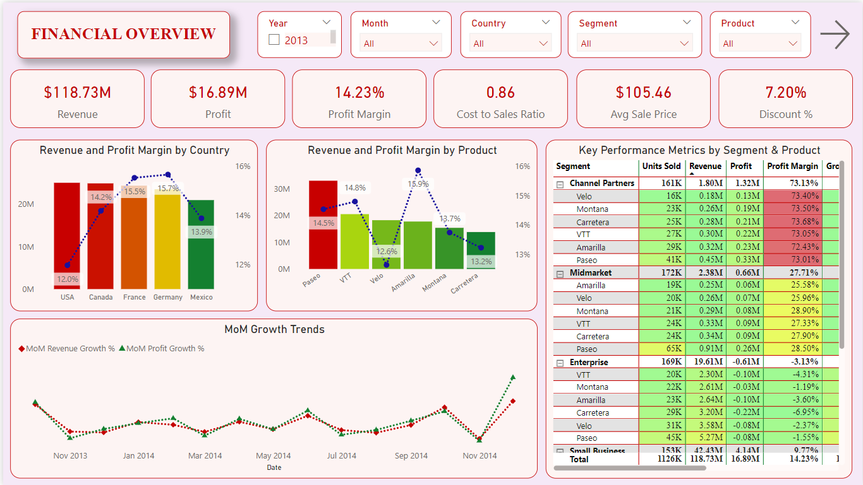
Provides a detailed overview of financial performance by country, product, and segment to identify key areas of profitability.

Slide 3
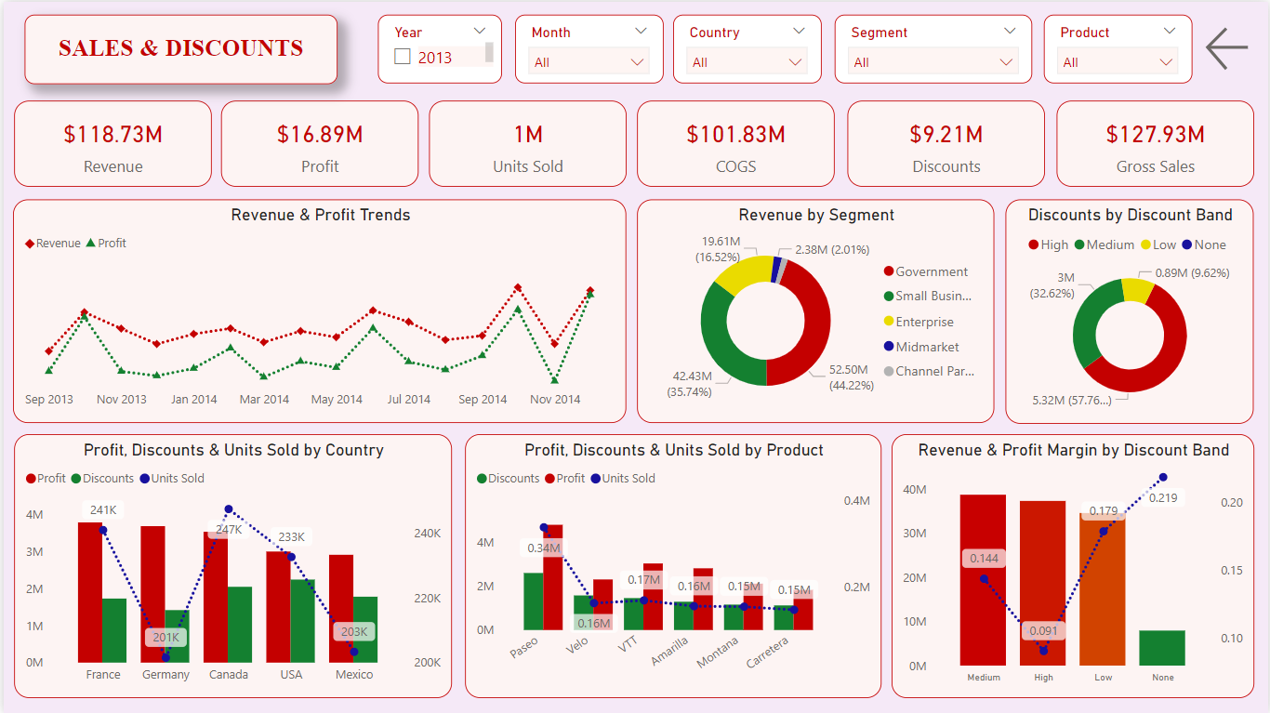
Analyses the impact of discounts on sales and profit across countries, products and segments

Slide 4
Insights:
$118.73M generated in revenue and $16.89M in profit, with a 14.23% profit margin and a cost-to-sales ratio of 0.86 with moderate discounts at 7.20%.
1M units were sold generating $127.93M in gross sales with $101.83M in COGS and $9.21M in discounts.
The USA generates the highest revenue among countries but has the lowest profit margin (12%).
France and Germany have highest profit margins (15.5% and 15.7%).
Among products, Amarilla has the highest profit margin (15.9%), while Velo has the lowest (12.6%) of all.
Paseo has the highest revenue while Carretera contributes the least.
Revenue and profit show noticeable month-over-month (MoM) growth spikes toward the end of 2014.
Channel Partners maintain consistent profit margins above 73%.
Government tops the market segment in terms of units sold, revenue, profit and discounts given.
Enterprise is the lowest performing market segment with a negative profit margin of 3.13%.

Slide 5
Insights:
Profit trends lag behind revenue trends.
Government segment contributes the most amount of revenue followed by small businesses and enterprises.
High discount band gives most discounts (58%) followed by medium (33%) and low (10%).
The high discount band shows the lowest profit margin (9.07%) while the none discount band shows the highest profit margin but has lowest revenue.
Medium and Low discount bands generate considerable revenue with good profit margins (14.39 % and 17.87%).
France and Germany lead in profit generation, whereas Mexico makes the least profit.
Canada sells most no. of products followed by France and USA.
USA gives the highest discounts ($2.3 M) despite making the second lowest profit($3 M).
Paseo leads in units sold, discounts as well as profit generated.
Carretera is the lowest performing product.

